Slide 1

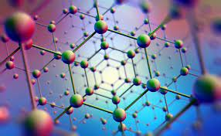
NANOTECHNOLOGY
OBJECTIVES
Conclusion
/
RECOMMENDATION
history
S & L
Contents
PRESENTATION
SUMMARY
introduction
OBJECTIVES
| Manipulating the World at the Molecular Level |

Slide 2

NANOTECHNOLOGY
v
Objectives
of the topic
01
Scope
and limitation
02
OBJECTIVES
Introduction
to Nanotechnology
TABLE OF CONTENTS
03
Conclusion
/
RECOMMENDATION
History
of Nanotechnology
history
04
S & L
Contents
PRESENTATION
SUMMARY
introduction
OBJECTIVES
Presentation
of Nanotechnology
05
Summary
of the topic
06
Conclusion
and recommendation
07
| Manipulating the World at the Molecular Level |

Slide 3

NANOTECHNOLOGY
v
Objectives
of the topic
01
TOPIC OBJECTIVES
Scope
and limitation
02
to provide an in-depth knowledge of nanotechnology
to examine the development of nanotechnology throughout time, from ancient times to the present
OBJECTIVES
TABLE OF CONTENTS
Introduction
to Nanotechnology
03
History
of Nanotechnology
Conclusion
/
RECOMMENDATION
to show the pros and cons of nanotechnology
04
to elaborate the importance of Nanotechnology
history
S & L
Contents
PRESENTATION
SUMMARY
introduction
OBJECTIVES
Presentation
of Nanotechnology
05
to explain how Nanotechnology works in different areas
to outline and describe some of the application areas of Nanotechnology
Summary
of the topic
06
Conclusion
and recommendation
07
| Manipulating the World at the Molecular Level |

Slide 4







NANOTECHNOLOGY
v
1
2
Objectives
of the topic
01
3
TOPIC OBJECTIVES
Scope
and limitation
Electronics and Computing
Medicine and Healthcare
02
Energy
and Environment
to provide an in-depth knowledge of nanotechnology
to examine the development of nanotechnology throughout time, from ancient times to the present
OBJECTIVES
TABLE OF CONTENTS
Introduction
to Nanotechnology
03
SCOPE AND LIMITATION
History
of Nanotechnology
Conclusion
/
RECOMMENDATION
to show the pros and cons of nanotechnology
04
to elaborate the importance of Nanotechnology
history
S & L
PRESENTATION
Contents
SUMMARY
introduction
OBJECTIVES
5
Presentation
of Nanotechnology
4
05
6
to explain how Nanotechnology works in different areas
to outline and describe some of the application areas of Nanotechnology
Summary
of the topic
Materials
Science
Nanoelectronics and
Photonics
06
Nanosensors and Nanodevices
Conclusion
and recommendation
07
| Manipulating the World at the Molecular Level |

Slide 5
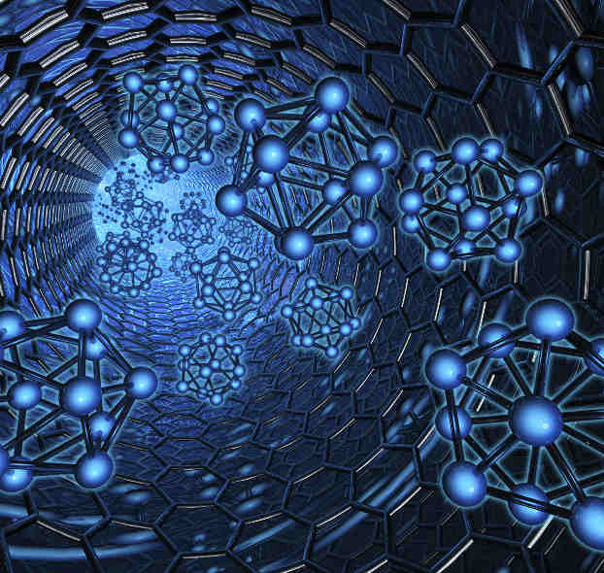
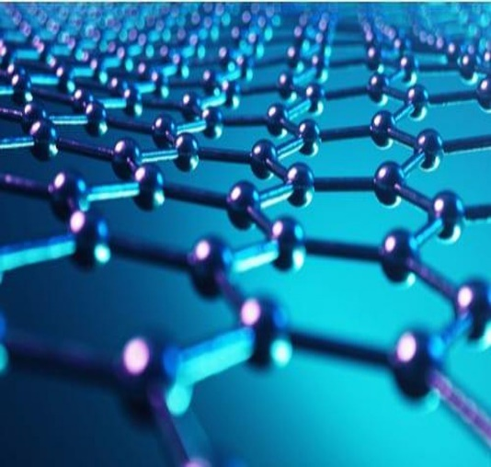

NANOTECHNOLOGY
v
Introduction to Nanotechnology
Objectives
of the topic
1
2
01
3
TOPIC OBJECTIVES
What is Nanotech?
Scope
and limitation
Electronics and Computing
Medicine and Healthcare
02
Energy
and Environment
to provide an in-depth knowledge of nanotechnology
to examine the development of nanotechnology throughout time, from ancient times to the present
OBJECTIVES
TABLE OF CONTENTS
Introduction
to Nanotechnology
03
Nanotechnology refers to the branch of science and engineering devoted to designing, producing, and using structures, devices, and systems by manipulating atoms and molecules at nanoscale.
SCOPE AND LIMITATION
History
of Nanotechnology
Conclusion
/
RECOMMENDATION
to show the pros and cons of nanotechnology
04
to elaborate the importance of Nanotechnology
history
S & L
PRESENTATION
Contents
SUMMARY
introduction
OBJECTIVES
5
Presentation
of Nanotechnology
4
05
6
to explain how Nanotechnology works in different areas
to outline and describe some of the application areas of Nanotechnology
In the natural world, there are many examples of structures with one or more nanometer dimensions, and many technologies have incidentally involved such nanostructures for many years, but only recently has it been possible to do it intentionally.
Summary
of the topic
Materials
Science
Nanoelectronics and
Photonics
06
Nanosensors and Nanodevices
Conclusion
and recommendation
07
| Manipulating the World at the Molecular Level |

Slide 6


NANOTECHNOLOGY
v
Introduction to Nanotechnology
Objectives
of the topic
History of Nanotechnology
1
2
01
3
TOPIC OBJECTIVES
What is Nanotech?
Scope
and limitation
Examples of Discoveries and Developments Enabling Nanotechnology from Pre-modern Era to Modern Era
Electronics and Computing
Medicine and Healthcare
02
Energy
and Environment
to provide an in-depth knowledge of nanotechnology
to examine the development of nanotechnology throughout time, from ancient times to the present
OBJECTIVES
TABLE OF CONTENTS
Introduction
to Nanotechnology
03
Nanotechnology refers to the branch of science and engineering devoted to designing, producing, and using structures, devices, and systems by manipulating atoms and molecules at nanoscale.
SCOPE AND LIMITATION
History
of Nanotechnology
Conclusion
/
RECOMMENDATION
to show the pros and cons of nanotechnology
04
to elaborate the importance of Nanotechnology
history
S & L
PRESENTATION
Contents
SUMMARY
introduction
OBJECTIVES
5
Presentation
of Nanotechnology
4
05
6
to explain how Nanotechnology works in different areas
to outline and describe some of the application areas of Nanotechnology
In the natural world, there are many examples of structures with one or more nanometer dimensions, and many technologies have incidentally involved such nanostructures for many years, but only recently has it been possible to do it intentionally.
Summary
of the topic
Materials
Science
Nanoelectronics and
Photonics
06
Nanosensors and Nanodevices
Conclusion
and recommendation
07
| Manipulating the World at the Molecular Level |

Slide 7
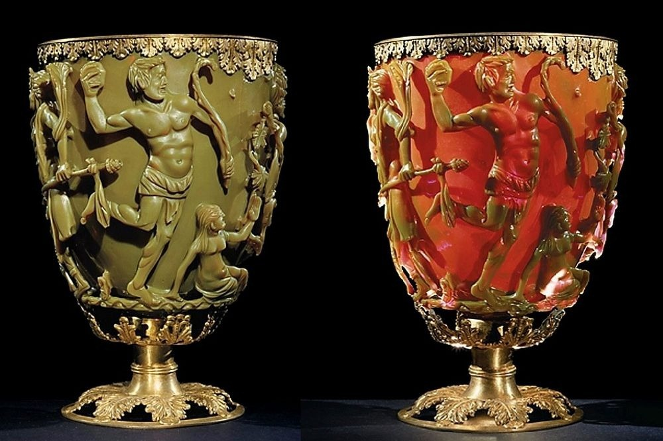

NANOTECHNOLOGY
v
Introduction to Nanotechnology
Objectives
of the topic
History of Nanotechnology
1
2
01
3
TOPIC OBJECTIVES
What is Nanotech?
Scope
and limitation
Examples of Discoveries and Developments Enabling Nanotechnology from Pre-modern Era to Modern Era
Electronics and Computing
Medicine and Healthcare
02
Energy
and Environment
to provide an in-depth knowledge of nanotechnology
to examine the development of nanotechnology throughout time, from ancient times to the present
THE
OBJECTIVES
TABLE OF CONTENTS
Introduction
to Nanotechnology
03
Nanotechnology refers to the branch of science and engineering devoted to designing, producing, and using structures, devices, and systems by manipulating atoms and molecules at nanoscale.
HISTORY OF
SCOPE AND LIMITATION
History
of Nanotechnology
Conclusion
/
RECOMMENDATION
to show the pros and cons of nanotechnology
04
to elaborate the importance of Nanotechnology
history
S & L
PRESENTATION
Contents
SUMMARY
introduction
OBJECTIVES
5
Presentation
of Nanotechnology
6
NANOTECHNOLOGY
4
05
to explain how Nanotechnology works in different areas
to outline and describe some of the application areas of Nanotechnology
In the natural world, there are many examples of structures with one or more nanometer dimensions, and many technologies have incidentally involved such nanostructures for many years, but only recently has it been possible to do it intentionally.
Summary
of the topic
Materials
Science
Nanoelectronics and
Photonics
06
Nanosensors and Nanodevices
Conclusion
and recommendation
07
| Manipulating the World at the Molecular Level |

Slide 8

THE
HISTORY OF
NANOTECHNOLOGY
IN 4TH CENTURY…
IN 9TH – 7TH CENTURY…
The Lycurgus Cup (Rome) is an example of dichroic glass; colloidal gold and silver in the glass allow it to look opaque green when lit from outside but translucent red when light shines through the inside.
Glowing, glittering “luster” ceramic glazes used in the Islamic world, and later in Europe, contained silver or copper or other metallic nanoparticles.

Slide 9

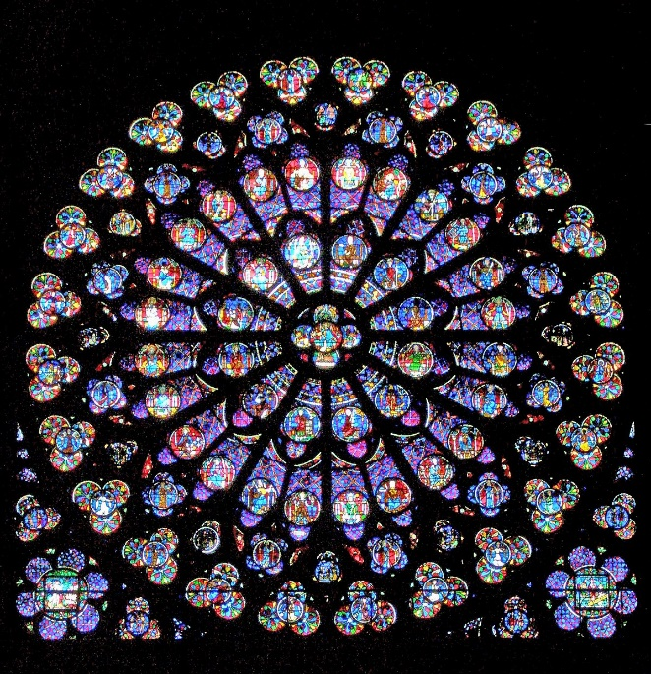
THE
HISTORY OF
IN 6TH – 15TH CENTURIES…
NANOTECHNOLOGY
Vibrant stained glass windows in European cathedrals owed their rich colors to nanoparticles of gold chloride and other metal oxides and chlorides; gold nanoparticles also acted as photocatalytic air purifiers.
IN 9TH – 7TH CENTURY…
IN 4TH CENTURY…
“Damascus” saber blades contained carbon nanotubes and cementite nanowires an ultrahigh-carbon steel formulation that gave them strength, resilience, the ability to hold a keen edge, and a visible moiré pattern in the steel that give the blades their name.
The Lycurgus Cup (Rome) is an example of dichroic glass; colloidal gold and silver in the glass allow it to look opaque green when lit from outside but translucent red when light shines through the inside.
Glowing, glittering “luster” ceramic glazes used in the Islamic world, and later in Europe, contained silver or copper or other metallic nanoparticles.
IN 13TH – 18TH CENTURIES…

Slide 10
THE
HISTORY OF
NANOTECHNOLOGY
IN 6TH – 15TH CENTURIES…
Vibrant stained glass windows in European cathedrals owed their rich colors to nanoparticles of gold chloride and other metal oxides and chlorides; gold nanoparticles also acted as photocatalytic air purifiers.
“Damascus” saber blades contained carbon nanotubes and cementite nanowires an ultrahigh-carbon steel formulation that gave them strength, resilience, the ability to hold a keen edge, and a visible moiré pattern in the steel that give the blades their name.
IN 13TH – 18TH CENTURIES…
Glowing, glittering “luster” ceramic glazes used in the Islamic world, and later in Europe, contained silver or copper or other metallic nanoparticles.

Slide 11
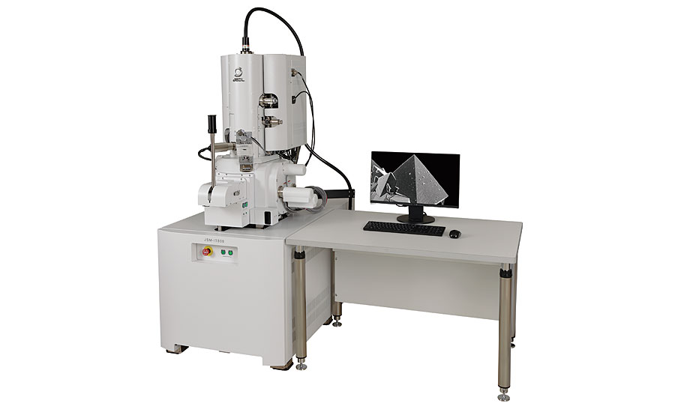
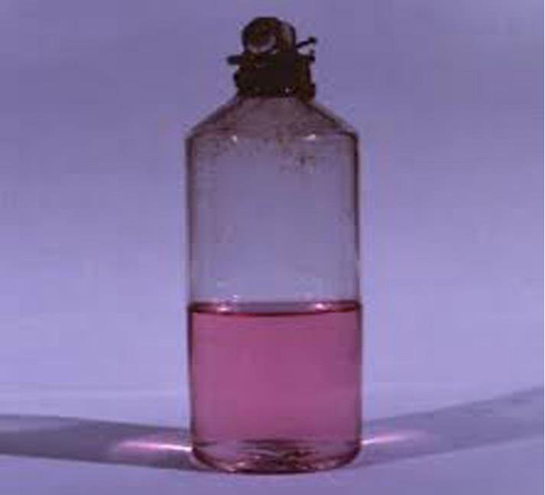
THE
HISTORY OF
IN 6TH – 15TH CENTURIES…
NANOTECHNOLOGY
IN 1936…
IN 1857…
Vibrant stained glass windows in European cathedrals owed their rich colors to nanoparticles of gold chloride and other metal oxides and chlorides; gold nanoparticles also acted as photocatalytic air purifiers.
“Damascus” saber blades contained carbon nanotubes and cementite nanowires an ultrahigh-carbon steel formulation that gave them strength, resilience, the ability to hold a keen edge, and a visible moiré pattern in the steel that give the blades their name.
Michael Faraday discovered colloidal “ruby” gold, demonstrating that nanostructured gold under certain lighting conditions produces different-colored solutions.
Erwin Müller, working at Siemens Research Laboratory, invented the field emission microscope, allowing near-atomic-resolution images of materials.
IN 13TH – 18TH CENTURIES…

Slide 12
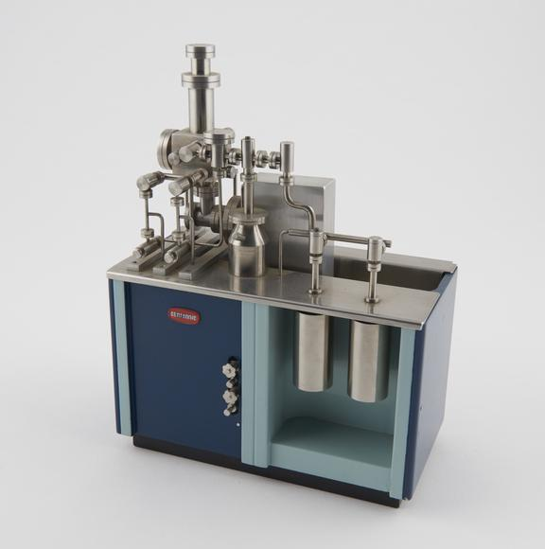
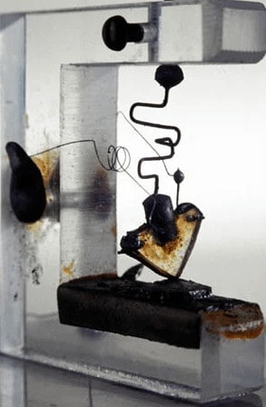
THE
HISTORY OF
NANOTECHNOLOGY
IN 1951…
John Bardeen, William Shockley, and Walter Brattain at Bell Labs discovered the semiconductor transistor and greatly expanded scientific knowledge of semiconductor interfaces, laying the foundation for electronic devices and the Information Age.
IN 1936…
IN 1857…
Michael Faraday discovered colloidal “ruby” gold, demonstrating that nanostructured gold under certain lighting conditions produces different-colored solutions.
Erwin Müller, working at Siemens Research Laboratory, invented the field emission microscope, allowing near-atomic-resolution images of materials.
IN 1947…
IN 13TH – 18TH CENTURIES…
Erwin Müller pioneered the field ion microscope, a means to image the arrangement of atoms at the surface of a sharp metal tip; he first imaged tungsten atoms.

Slide 13
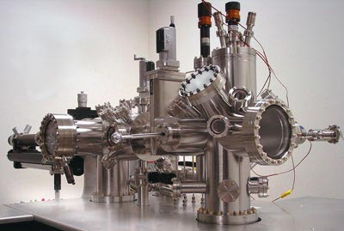
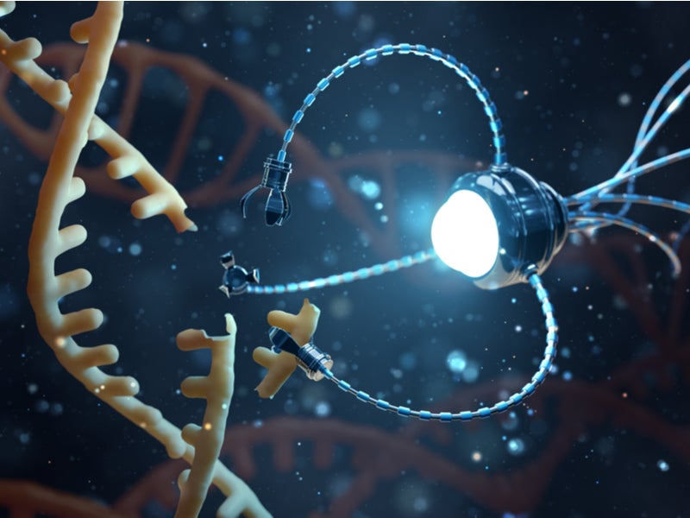
THE
HISTORY OF
NANOTECHNOLOGY
John Bardeen, William Shockley, and Walter Brattain at Bell Labs discovered the semiconductor transistor and greatly expanded scientific knowledge of semiconductor interfaces, laying the foundation for electronic devices and the Information Age.
IN 1951…
IN 1936…
Erwin Müller, working at Siemens Research Laboratory, invented the field emission microscope, allowing near-atomic-resolution images of materials.
Erwin Müller pioneered the field ion microscope, a means to image the arrangement of atoms at the surface of a sharp metal tip; he first imaged tungsten atoms.
IN 1947…

Slide 14
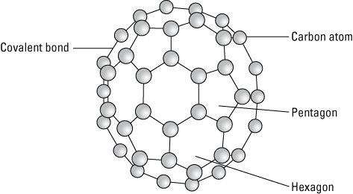
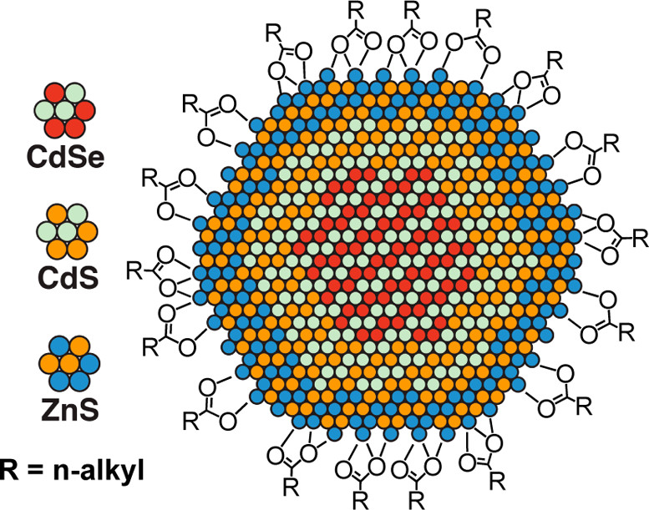
John Bardeen, William Shockley, and Walter Brattain at Bell Labs discovered the semiconductor transistor and greatly expanded scientific knowledge of semiconductor interfaces, laying the foundation for electronic devices and the Information Age.
THE
HISTORY OF
NANOTECHNOLOGY
IN 1951…
IN 1981…
Gerd Binnig and Heinrich Rohrer at IBM’s Zurich lab invented the scanning tunneling microscope, allowing scientists to "see" (create direct spatial images of) individual atoms for the first time. Binnig and Rohrer won the Nobel Prize for this discovery in 1986.
IN 1947…
Erwin Müller pioneered the field ion microscope, a means to image the arrangement of atoms at the surface of a sharp metal tip; he first imaged tungsten atoms.

Slide 15
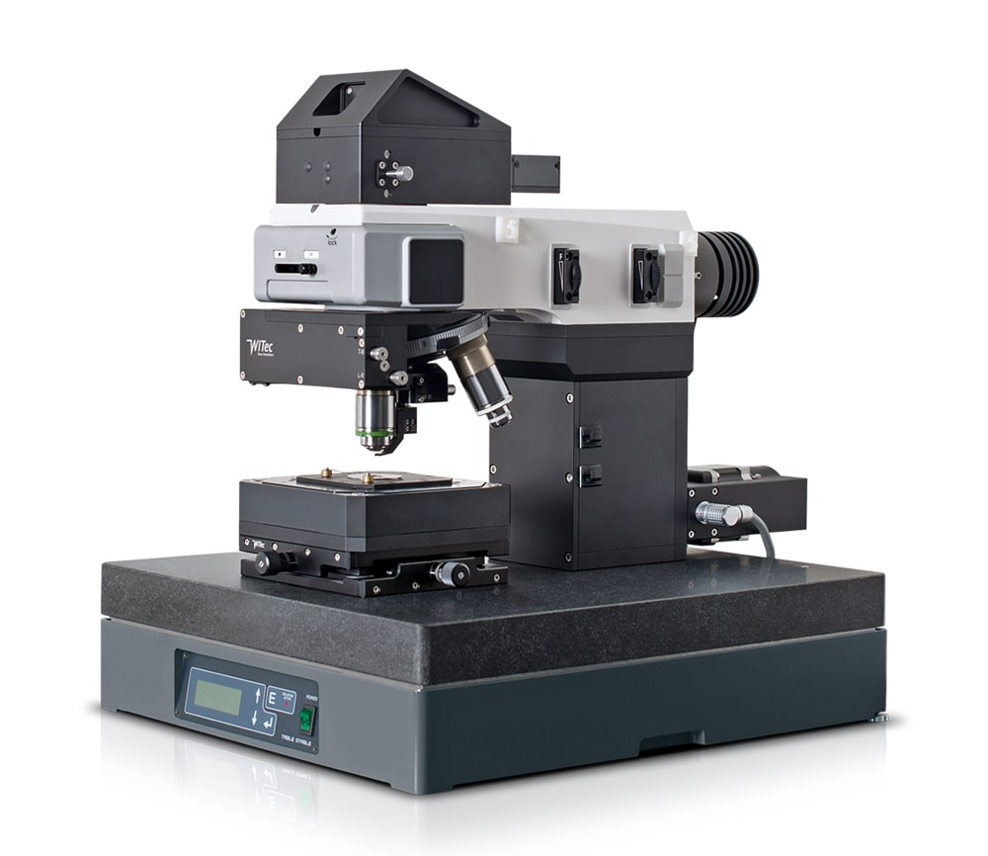
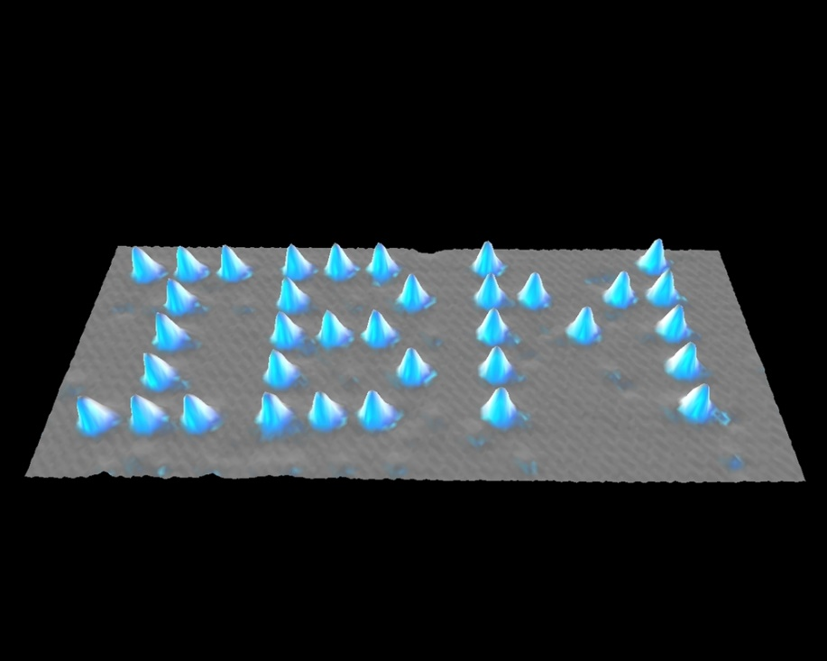
THE
HISTORY OF
NANOTECHNOLOGY
IN 1986…
Rice University researchers Harold Kroto, Sean O’Brien, Robert Curl, and Richard Smalley discovered the Buckminsterfullerene (C60), more commonly known as the buckyball, which is a molecule resembling a soccer ball in shape and composed entirely of carbon, as are graphite and diamond. The team was awarded the 1996 Nobel Prize in Chemistry for their roles in this discovery and that of the fullerene class of molecules more generally.
IN 1981…
Gerd Binnig, Calvin Quate, and Christoph Gerber invented the atomic force microscope, which has the capability to view, measure, and manipulate materials down to fractions of a nanometer in size, including measurement of various forces intrinsic to nanomaterials.
IN 1985…
Gerd Binnig and Heinrich Rohrer at IBM’s Zurich lab invented the scanning tunneling microscope, allowing scientists to "see" (create direct spatial images of) individual atoms for the first time. Binnig and Rohrer won the Nobel Prize for this discovery in 1986.
Don Eigler and Erhard Schweizer at IBM's Almaden Research Center manipulated 35 individual xenon atoms to spell out the IBM logo. This demonstration of the ability to precisely manipulate atoms ushered in the applied use of nanotechnology.
Bell Labs’s Louis Brus discovered colloidal semiconductor nanocrystals (quantum dots), for which he shared the 2008 Kavli Prize in Nanotechnology.
IN 1989…
IN 1947…

Slide 16
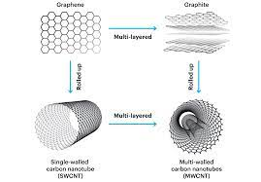
THE
HISTORY OF
IN 1985…
NANOTECHNOLOGY
IN 1986…
Rice University researchers Harold Kroto, Sean O’Brien, Robert Curl, and Richard Smalley discovered the Buckminsterfullerene (C60), more commonly known as the buckyball, which is a molecule resembling a soccer ball in shape and composed entirely of carbon, as are graphite and diamond. The team was awarded the 1996 Nobel Prize in Chemistry for their roles in this discovery and that of the fullerene class of molecules more generally.
Gerd Binnig, Calvin Quate, and Christoph Gerber invented the atomic force microscope, which has the capability to view, measure, and manipulate materials down to fractions of a nanometer in size, including measurement of various forces intrinsic to nanomaterials.
Don Eigler and Erhard Schweizer at IBM's Almaden Research Center manipulated 35 individual xenon atoms to spell out the IBM logo. This demonstration of the ability to precisely manipulate atoms ushered in the applied use of nanotechnology.
Bell Labs’s Louis Brus discovered colloidal semiconductor nanocrystals (quantum dots), for which he shared the 2008 Kavli Prize in Nanotechnology.
IN 1989…

Slide 17
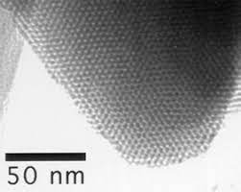
THE
HISTORY OF
MCM-41 is a "mesoporous molecular sieve" silica nanomaterial with a hexagonal or "honeycomb" arrangement of its straight cylindrical pores
NANOTECHNOLOGY
IN 1986…
IN 1991…
Gerd Binnig, Calvin Quate, and Christoph Gerber invented the atomic force microscope, which has the capability to view, measure, and manipulate materials down to fractions of a nanometer in size, including measurement of various forces intrinsic to nanomaterials.
Sumio Iijima of NEC is credited with discovering the carbon nanotube (CNT), although there were early observations of tubular carbon structures by others as well. Iijima shared the Kavli Prize in Nanoscience in 2008 for this advance and other advances in the field. CNTs, like buckyballs, are entirely composed of carbon, but in a tubular shape. They exhibit extraordinary properties in terms of strength, electrical and thermal conductivity, among others.
C.T. Kresge and colleagues at Mobil Oil discovered the nanostructured catalytic materials MCM-41 and MCM-48, now used heavily in refining crude oil as well as for drug delivery, water treatment, and other varied applications.
Don Eigler and Erhard Schweizer at IBM's Almaden Research Center manipulated 35 individual xenon atoms to spell out the IBM logo. This demonstration of the ability to precisely manipulate atoms ushered in the applied use of nanotechnology.
IN 1989…
IN 1992…

Slide 18
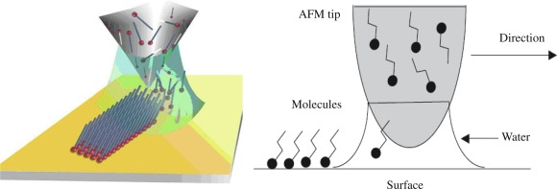

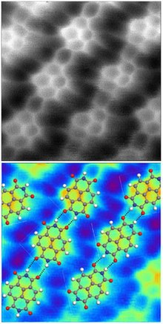
THE
HISTORY OF
IN 1991…
NANOTECHNOLOGY
MCM-41 is a "mesoporous molecular sieve" silica nanomaterial with a hexagonal or "honeycomb" arrangement of its straight cylindrical pores
C.T. Kresge and colleagues at Mobil Oil discovered the nanostructured catalytic materials MCM-41 and MCM-48, now used heavily in refining crude oil as well as for drug delivery, water treatment, and other varied applications.
IN 1992…
Sumio Iijima of NEC is credited with discovering the carbon nanotube (CNT), although there were early observations of tubular carbon structures by others as well. Iijima shared the Kavli Prize in Nanoscience in 2008 for this advance and other advances in the field. CNTs, like buckyballs, are entirely composed of carbon, but in a tubular shape. They exhibit extraordinary properties in terms of strength, electrical and thermal conductivity, among others.

Slide 19
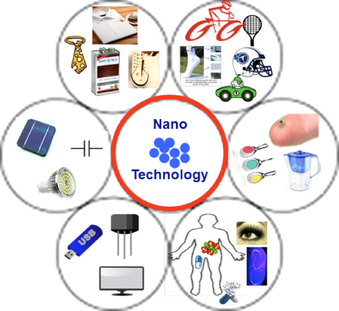
THE
HISTORY OF
MCM-41 is a "mesoporous molecular sieve" silica nanomaterial with a hexagonal or "honeycomb" arrangement of its straight cylindrical pores
NANOTECHNOLOGY
Cornell University researchers Wilson Ho and Hyojune Lee probed secrets of chemical bonding by assembling a molecule [iron carbonyl Fe(CO)2] from constituent components [iron (Fe) and carbon monoxide (CO)] with a scanning tunneling microscope
Consumer products making use of nanotechnology began appearing in the marketplace, including lightweight nanotechnology-enabled automobile bumpers that resist denting and scratching, golf balls that fly straighter, tennis rackets that are stiffer (therefore, the ball rebounds faster), baseball bats with better flex and "kick," nano-silver antibacterial socks, clear sunscreens, wrinkle- and stain-resistant clothing, deep-penetrating therapeutic cosmetics, scratch-resistant glass coatings, faster-recharging batteries for cordless electric tools, and improved displays for televisions, cell phones, and digital cameras.
IN 1999…
Chad Mirkin at Northwestern University invented dip-pen nanolithography (DPN), leading to manufacturable, reproducible “writing” of electronic circuits as well as patterning of biomaterials for cell biology research, nanoencryption, and other applications.
IN 1992…

Slide 20
THE
HISTORY OF
NANOTECHNOLOGY
IN 1999- EARLY 2000’S…
Cornell University researchers Wilson Ho and Hyojune Lee probed secrets of chemical bonding by assembling a molecule [iron carbonyl Fe(CO)2] from constituent components [iron (Fe) and carbon monoxide (CO)] with a scanning tunneling microscope
Consumer products making use of nanotechnology began appearing in the marketplace, including lightweight nanotechnology-enabled automobile bumpers that resist denting and scratching, golf balls that fly straighter, tennis rackets that are stiffer (therefore, the ball rebounds faster), baseball bats with better flex and "kick," nano-silver antibacterial socks, clear sunscreens, wrinkle- and stain-resistant clothing, deep-penetrating therapeutic cosmetics, scratch-resistant glass coatings, faster-recharging batteries for cordless electric tools, and improved displays for televisions, cell phones, and digital cameras.
Chad Mirkin at Northwestern University invented dip-pen nanolithography (DPN), leading to manufacturable, reproducible “writing” of electronic circuits as well as patterning of biomaterials for cell biology research, nanoencryption, and other applications.

Slide 21
IN 1999- EARLY 2000’S…
THE
Consumer products making use of nanotechnology began appearing in the marketplace, including lightweight nanotechnology-enabled automobile bumpers that resist denting and scratching, golf balls that fly straighter, tennis rackets that are stiffer (therefore, the ball rebounds faster), baseball bats with better flex and "kick," nano-silver antibacterial socks, clear sunscreens, wrinkle- and stain-resistant clothing, deep-penetrating therapeutic cosmetics, scratch-resistant glass coatings, faster-recharging batteries for cordless electric tools, and improved displays for televisions, cell phones, and digital cameras.
HISTORY OF
NANOTECHNOLOGY

Slide 22

NANOTECHNOLOGY
v
Introduction to Nanotechnology
Objectives
of the topic
History of Nanotechnology
1
2
01
3
TOPIC OBJECTIVES
What is Nanotech?
Scope
and limitation
Examples of Discoveries and Developments Enabling Nanotechnology from Pre-modern Era to Modern Era
Electronics and Computing
Medicine and Healthcare
02
Energy
and Environment
to provide an in-depth knowledge of nanotechnology
to examine the development of nanotechnology throughout time, from ancient times to the present
THE
OBJECTIVES
TABLE OF CONTENTS
Introduction
to Nanotechnology
03
Nanotechnology refers to the branch of science and engineering devoted to designing, producing, and using structures, devices, and systems by manipulating atoms and molecules at nanoscale.
HISTORY OF
SCOPE AND LIMITATION
History
of Nanotechnology
Conclusion
/
RECOMMENDATION
to show the pros and cons of nanotechnology
04
to elaborate the importance of Nanotechnology
history
S & L
PRESENTATION
Contents
SUMMARY
introduction
OBJECTIVES
5
Presentation
of Nanotechnology
6
NANOTECHNOLOGY
4
05
to explain how Nanotechnology works in different areas
to outline and describe some of the application areas of Nanotechnology
In the natural world, there are many examples of structures with one or more nanometer dimensions, and many technologies have incidentally involved such nanostructures for many years, but only recently has it been possible to do it intentionally.
Summary
of the topic
Materials
Science
Nanoelectronics and
Photonics
06
Nanosensors and Nanodevices
Conclusion
and recommendation
07
| Manipulating the World at the Molecular Level |

Slide 23
THE
HISTORY OF
NANOTECHNOLOGY
Introduction to Nanotechnology
Objectives
of the topic
History of Nanotechnology
1
2
01
3
TOPIC OBJECTIVES
What is Nanotech?
Scope
and limitation
Examples of Discoveries and Developments Enabling Nanotechnology from Pre-modern Era to Modern Era
Electronics and Computing
Medicine and Healthcare
02
Energy
and Environment
to provide an in-depth knowledge of nanotechnology
to examine the development of nanotechnology throughout time, from ancient times to the present
OBJECTIVES
TABLE OF CONTENTS
Introduction
to Nanotechnology
03
Nanotechnology refers to the branch of science and engineering devoted to designing, producing, and using structures, devices, and systems by manipulating atoms and molecules at nanoscale.
SCOPE AND LIMITATION
History
of Nanotechnology
Conclusion
/
RECOMMENDATION
to show the pros and cons of nanotechnology
04
to elaborate the importance of Nanotechnology
history
S & L
PRESENTATION
Contents
SUMMARY
introduction
OBJECTIVES
5
Presentation
of Nanotechnology
4
05
6
to explain how Nanotechnology works in different areas
to outline and describe some of the application areas of Nanotechnology
In the natural world, there are many examples of structures with one or more nanometer dimensions, and many technologies have incidentally involved such nanostructures for many years, but only recently has it been possible to do it intentionally.
Summary
of the topic
Materials
Science
Nanoelectronics and
Photonics
06
Nanosensors and Nanodevices
Conclusion
and recommendation
07

Slide 24









Introduction to Nanotechnology
Objectives
of the topic
History of Nanotechnology
1
2
01
3
PRESENTATION OF
NANOTECHNOLOGY
TOPIC OBJECTIVES
What is Nanotech?
Scope
and limitation
Examples of Discoveries and Developments Enabling Nanotechnology from Pre-modern Era to Modern Era
Electronics and Computing
Medicine and Healthcare
02
Energy
and Environment
to provide an in-depth knowledge of nanotechnology
to examine the development of nanotechnology throughout time, from ancient times to the present
OBJECTIVES
TABLE OF CONTENTS
Introduction
to Nanotechnology
03
Nanotechnology refers to the branch of science and engineering devoted to designing, producing, and using structures, devices, and systems by manipulating atoms and molecules at nanoscale.
SCOPE AND LIMITATION
History
of Nanotechnology
Conclusion
/
RECOMMENDATION
to show the pros and cons of nanotechnology
04
to elaborate the importance of Nanotechnology
history
S & L
SUMMARY
LITERATURE REVIEW AND SUPPORTING INFORMATION
Contents
PRESENTATION
introduction
USES AND
FUNCTIONS
IMPORTANCE AND BENEFITS
TECHNOLOGY OBSERVATIONS
OBJECTIVES
5
Presentation
of Nanotechnology
4
05
6
to explain how Nanotechnology works in different areas
to outline and describe some of the application areas of Nanotechnology
In the natural world, there are many examples of structures with one or more nanometer dimensions, and many technologies have incidentally involved such nanostructures for many years, but only recently has it been possible to do it intentionally.
Summary
of the topic
Materials
Science
Nanoelectronics and
Photonics
06
Nanosensors and Nanodevices
TECHNOLOGY LITERATURE REVIEW
SURVEYS AND TECHNOLOGY EVALUATION
Status of Nanotechnology in the Philippines
PROS
AND
CONS
Conclusion
and recommendation
07

Slide 25

Introduction to Nanotechnology
Uses and Functions
Objectives
of the topic
History of Nanotechnology
1
2
01
3
PRESENTATION OF
NANOTECHNOLOGY
TOPIC OBJECTIVES
The main goal of nanotechnology is to develop new substances, machines, and systems with special qualities and capabilities resulting from their tiny architectures. The following are some of the primary uses and applications of nanotechnology:
What is Nanotech?
Scope
and limitation
Examples of Discoveries and Developments Enabling Nanotechnology from Pre-modern Era to Modern Era
Electronics and Computing
Medicine and Healthcare
02
Energy
and Environment
to provide an in-depth knowledge of nanotechnology
to examine the development of nanotechnology throughout time, from ancient times to the present
Nanotechnology has had a significant impact on electronics and computing. It has led to the development of smaller, faster, and more efficient electronic components, such as transistors, memory devices, and sensors. Nanoscale materials, such as carbon nanotubes and graphene, have unique electrical properties and are being explored for use in future generations of electronics.
OBJECTIVES
TABLE OF CONTENTS
Introduction
to Nanotechnology
03
Electronic and Computing
Nanotechnology refers to the branch of science and engineering devoted to designing, producing, and using structures, devices, and systems by manipulating atoms and molecules at nanoscale.
SCOPE AND LIMITATION
History
of Nanotechnology
Conclusion
/
RECOMMENDATION
to show the pros and cons of nanotechnology
04
to elaborate the importance of Nanotechnology
history
Contents
SUMMARY
S & L
PRESENTATION
introduction
USES AND
FUNCTIONS
IMPORTANCE AND BENEFITS
LITERATURE REVIEW AND SUPPORTING INFORMATION
OBJECTIVES
5
Presentation
of Nanotechnology
4
05
6
to explain how Nanotechnology works in different areas
to outline and describe some of the application areas of Nanotechnology
Nanotechnology is being used to improve energy production, storage, and efficiency. For example, nanomaterials are being explored for more efficient solar cells and energy storage devices, such as batteries and supercapacitors. Nanotechnology is also applied in developing more efficient catalysts for fuel cells and improving the energy efficiency of buildings.
In the natural world, there are many examples of structures with one or more nanometer dimensions, and many technologies have incidentally involved such nanostructures for many years, but only recently has it been possible to do it intentionally.
Energy
Summary
of the topic
Materials
Science
Nanoelectronics and
Photonics
06
Nanosensors and Nanodevices
TECHNOLOGY OBSERVATIONS
TECHNOLOGY LITERATURE REVIEW
SURVEYS AND TECHNOLOGY EVALUATION
Conclusion
and recommendation
07

Slide 26
Introduction to Nanotechnology
Uses and Functions
Objectives
of the topic
History of Nanotechnology
1
2
01
3
PRESENTATION OF
NANOTECHNOLOGY
TOPIC OBJECTIVES
The main goal of nanotechnology is to develop new substances, machines, and systems with special qualities and capabilities resulting from their tiny architectures. The following are some of the primary uses and applications of nanotechnology:
What is Nanotech?
Scope
and limitation
Examples of Discoveries and Developments Enabling Nanotechnology from Pre-modern Era to Modern Era
Electronics and Computing
Medicine and Healthcare
02
Energy
and Environment
to provide an in-depth knowledge of nanotechnology
to examine the development of nanotechnology throughout time, from ancient times to the present
Nanotechnology has had a significant impact on electronics and computing. It has led to the development of smaller, faster, and more efficient electronic components, such as transistors, memory devices, and sensors. Nanoscale materials, such as carbon nanotubes and graphene, have unique electrical properties and are being explored for use in future generations of electronics.
The properties of some nanomaterials make them ideal for improving early diagnosis and treatment of neurodegenerative diseases or cancer. They are able to attack cancer cells selectively without harming other healthy cells. Some nanoparticles have also been used to enhance pharmaceutical products such as sunscreen.
OBJECTIVES
TABLE OF CONTENTS
Introduction
to Nanotechnology
Electronic and Computing
03
Nanotechnology refers to the branch of science and engineering devoted to designing, producing, and using structures, devices, and systems by manipulating atoms and molecules at nanoscale.
Biomedicine
SCOPE AND LIMITATION
History
of Nanotechnology
Conclusion
/
RECOMMENDATION
to show the pros and cons of nanotechnology
04
to elaborate the importance of Nanotechnology
history
Contents
SUMMARY
S & L
PRESENTATION
introduction
USES AND
FUNCTIONS
IMPORTANCE AND BENEFITS
LITERATURE REVIEW AND SUPPORTING INFORMATION
OBJECTIVES
5
Presentation
of Nanotechnology
4
05
6
to explain how Nanotechnology works in different areas
to outline and describe some of the application areas of Nanotechnology
Nanotechnology is being used to improve energy production, storage, and efficiency. For example, nanomaterials are being explored for more efficient solar cells and energy storage devices, such as batteries and supercapacitors. Nanotechnology is also applied in developing more efficient catalysts for fuel cells and improving the energy efficiency of buildings.
Air purification with ions, wastewater purification with nanobubbles or nanofiltration systems for heavy metals are some of its environmentally-friendly applications. Nanocatalysts are also available to make chemical reactions more efficient and less polluting.
In the natural world, there are many examples of structures with one or more nanometer dimensions, and many technologies have incidentally involved such nanostructures for many years, but only recently has it been possible to do it intentionally.
Energy
Summary
of the topic
Environment
Materials
Science
Nanoelectronics and
Photonics
06
Nanosensors and Nanodevices
TECHNOLOGY OBSERVATIONS
TECHNOLOGY LITERATURE REVIEW
SURVEYS AND TECHNOLOGY EVALUATION
Conclusion
and recommendation
07

Slide 27
Introduction to Nanotechnology
Uses and Functions
Objectives
of the topic
History of Nanotechnology
1
2
01
3
PRESENTATION OF
NANOTECHNOLOGY
TOPIC OBJECTIVES
The main goal of nanotechnology is to develop new substances, machines, and systems with special qualities and capabilities resulting from their tiny architectures. The following are some of the primary uses and applications of nanotechnology:
What is Nanotech?
Scope
and limitation
Examples of Discoveries and Developments Enabling Nanotechnology from Pre-modern Era to Modern Era
Electronics and Computing
Medicine and Healthcare
02
Energy
and Environment
to provide an in-depth knowledge of nanotechnology
to examine the development of nanotechnology throughout time, from ancient times to the present
In this field, nanobiosensors could be used to detect the presence of pathogens in food or nanocomposites to improve food production by increasing mechanical and thermal resistance and decreasing oxygen transfer in packaged products.
OBJECTIVES
The properties of some nanomaterials make them ideal for improving early diagnosis and treatment of neurodegenerative diseases or cancer. They are able to attack cancer cells selectively without harming other healthy cells. Some nanoparticles have also been used to enhance pharmaceutical products such as sunscreen.
TABLE OF CONTENTS
Introduction
to Nanotechnology
03
Nanotechnology refers to the branch of science and engineering devoted to designing, producing, and using structures, devices, and systems by manipulating atoms and molecules at nanoscale.
Food
Biomedicine
SCOPE AND LIMITATION
History
of Nanotechnology
Conclusion
/
RECOMMENDATION
to show the pros and cons of nanotechnology
04
to elaborate the importance of Nanotechnology
history
Contents
SUMMARY
S & L
PRESENTATION
introduction
USES AND
FUNCTIONS
IMPORTANCE AND BENEFITS
LITERATURE REVIEW AND SUPPORTING INFORMATION
OBJECTIVES
5
Presentation
of Nanotechnology
4
05
6
to explain how Nanotechnology works in different areas
to outline and describe some of the application areas of Nanotechnology
Nanotechnology makes it possible to develop smart fabrics that don't stain nor wrinkle, as well as stronger, lighter and more durable materials to make motorcycle helmets or sports equipment.
In the natural world, there are many examples of structures with one or more nanometer dimensions, and many technologies have incidentally involved such nanostructures for many years, but only recently has it been possible to do it intentionally.
Air purification with ions, wastewater purification with nanobubbles or nanofiltration systems for heavy metals are some of its environmentally-friendly applications. Nanocatalysts are also available to make chemical reactions more efficient and less polluting.
Textile
Summary
of the topic
Materials
Science
Nanoelectronics and
Photonics
06
Nanosensors and Nanodevices
Environment
TECHNOLOGY OBSERVATIONS
TECHNOLOGY LITERATURE REVIEW
SURVEYS AND TECHNOLOGY EVALUATION
Conclusion
and recommendation
07

Slide 28

Literature Reviews and Supporting Information
The main goal of nanotechnology is to develop new substances, machines, and systems with special qualities and capabilities resulting from their tiny architectures. The following are some of the primary uses and applications of nanotechnology:
Introduction to Nanotechnology
Objectives
of the topic
Uses and Functions
History of Nanotechnology
Importance and Benefits
1
2
01
3
Nanotechnology is a multidisciplinary field that includes a vast and diverse array of devices that derived from engineering, physics, chemistry, and biology leading to the development of structures, devices and systems that have novel functional properties by size ranging between 1 and 100 nm (Neethirajan and Jayas 2010; Borm et al, 2006; Ducan 2011). Nanotechnology involves the manipulation of materials at nanometer sizes leading to the fabrication of nanodevices to enhance their performance.
PRESENTATION OF
NANOTECHNOLOGY
TOPIC OBJECTIVES
The impact of nanotechnology extends from its medical, ethical, mental, and environmental applications, to fields such as engineering, biology, chemistry, computing, materials science, and communications. Major benefits of nanotechnology include improved manufacturing methods, water purification systems, energy systems, physical enhancement, nanomedicine, better food production methods, nutrition and large-scale infrastructure auto-fabrication. Nanotechnology's reduced size may allow for automation of tasks which were previously inaccessible due to physical restrictions, which in turn may reduce labor, land, or maintenance requirements placed on humans.
What is Nanotech?
Scope
and limitation
Examples of Discoveries and Developments Enabling Nanotechnology from Pre-modern Era to Modern Era
Electronics and Computing
Medicine and Healthcare
02
Energy
and Environment
to provide an in-depth knowledge of nanotechnology
to examine the development of nanotechnology throughout time, from ancient times to the present
OBJECTIVES
In this field, nanobiosensors could be used to detect the presence of pathogens in food or nanocomposites to improve food production by increasing mechanical and thermal resistance and decreasing oxygen transfer in packaged products.
TABLE OF CONTENTS
Introduction
to Nanotechnology
03
Nanotechnology refers to the branch of science and engineering devoted to designing, producing, and using structures, devices, and systems by manipulating atoms and molecules at nanoscale.
Medical
Nanotechnology has extensive application as nanomedicine in the medical field. Some nanoparticles have possible applications in novel diagnostic instruments, imagery and methodologies, targeted medicinal products, pharmaceutical products, biomedical implants, and tissue engineering. Today treatments of high toxicity can be administered with improved safety using nanotechnology, such as chemotherapeutic cancer drugs.
Food
1
SCOPE AND LIMITATION
History
of Nanotechnology
Conclusion
/
RECOMMENDATION
to show the pros and cons of nanotechnology
04
to elaborate the importance of Nanotechnology
history
S & L
SUMMARY
Contents
PRESENTATION
introduction
IMPORTANCE AND BENEFITS
LITERATURE REVIEW AND SUPPORTING INFORMATION
OBJECTIVES
Ethical
Considering the significant risks associated with nanotechnology, it is crucial to thoroughly evaluate its potential repercussions. While it is possible that nanotechnology may not reach the level of advancement anticipated by its proponents, it is prudent to proactively address any ethical concerns that may arise before the technology becomes firmly established in society.
USES AND
FUNCTIONS
2
5
Presentation
of Nanotechnology
4
05
6
Mental
Nanotechnology can potentially have both positive and negative impacts on mental health. On the positive side, nanotechnology-based advancements in diagnostics and treatment options can lead to more effective and personalized approaches for mental health disorders. However, it is essential to consider the potential risks and ethical implications associated with nanotechnology. The use of nanomaterials in brain interfaces or implants raises concerns regarding long-term safety, privacy, and the potential for unintended consequences.
to explain how Nanotechnology works in different areas
to outline and describe some of the application areas of Nanotechnology
Nanotechnology makes it possible to develop smart fabrics that don't stain nor wrinkle, as well as stronger, lighter and more durable materials to make motorcycle helmets or sports equipment.
In the natural world, there are many examples of structures with one or more nanometer dimensions, and many technologies have incidentally involved such nanostructures for many years, but only recently has it been possible to do it intentionally.
3
Summary
of the topic
Textile
Materials
Science
Nanoelectronics and
Photonics
06
Nanosensors and Nanodevices
TECHNOLOGY OBSERVATIONS
TECHNOLOGY LITERATURE REVIEW
SURVEYS AND TECHNOLOGY EVALUATION
Environmental
The environmental impact of nanotechnology is the possible effects that the use of nanotechnological materials and devices will have on the environment. As nanotechnology is an emerging field, there is debate regarding to what extent industrial and commercial use of nanomaterials will affect organisms and ecosystems. Nanotechnology's environmental impact can be split into two aspects: the potential for nanotechnological innovations to help improve the environment, and the possibly novel type of pollution that nanotechnological materials might cause if released into the environment.
4
Conclusion
and recommendation
07

Slide 29

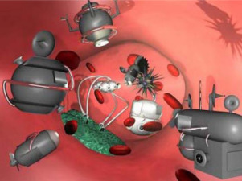
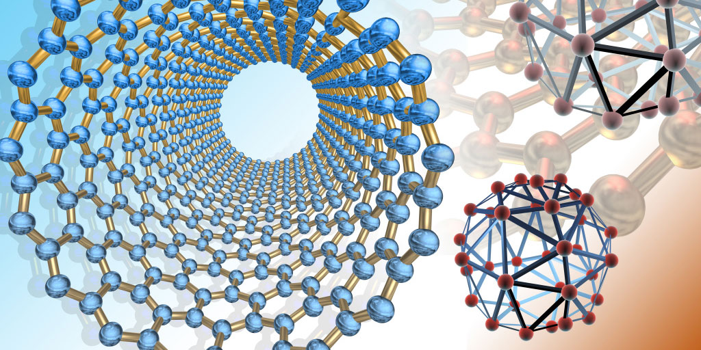
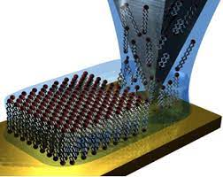


Importance and Benefits
Introduction to Nanotechnology
Literature Reviews and Supporting Information
Technology Observations:
History of Nanotechnology
Objectives
of the topic
1
2
01
3
Nanotechnology is a multidisciplinary field that includes a vast and diverse array of devices that derived from engineering, physics, chemistry, and biology leading to the development of structures, devices and systems that have novel functional properties by size ranging between 1 and 100 nm (Neethirajan and Jayas 2010; Borm et al, 2006; Ducan 2011). Nanotechnology involves the manipulation of materials at nanometer sizes leading to the fabrication of nanodevices to enhance their performance.
PRESENTATION OF
NANOTECHNOLOGY
The impact of nanotechnology extends from its medical, ethical, mental, and environmental applications, to fields such as engineering, biology, chemistry, computing, materials science, and communications. Major benefits of nanotechnology include improved manufacturing methods, water purification systems, energy systems, physical enhancement, nanomedicine, better food production methods, nutrition and large-scale infrastructure auto-fabrication. Nanotechnology's reduced size may allow for automation of tasks which were previously inaccessible due to physical restrictions, which in turn may reduce labor, land, or maintenance requirements placed on humans.
TOPIC OBJECTIVES
What is Nanotech?
Scope
and limitation
Examples of Discoveries and Developments Enabling Nanotechnology from Pre-modern Era to Modern Era
Electronics and Computing
Medicine and Healthcare
02
Energy
and Environment
to provide an in-depth knowledge of nanotechnology
to examine the development of nanotechnology throughout time, from ancient times to the present
OBJECTIVES
TABLE OF CONTENTS
Introduction
to Nanotechnology
03
Medical
Nanotechnology has extensive application as nanomedicine in the medical field. Some nanoparticles have possible applications in novel diagnostic instruments, imagery and methodologies, targeted medicinal products, pharmaceutical products, biomedical implants, and tissue engineering. Today treatments of high toxicity can be administered with improved safety using nanotechnology, such as chemotherapeutic cancer drugs.
Nanotechnology refers to the branch of science and engineering devoted to designing, producing, and using structures, devices, and systems by manipulating atoms and molecules at nanoscale.
Nanotools – tools and techniques for synthesizing nanomaterials, manipulating atoms and fabricating device structures, and very importantly for measuring and characterizing materials and devices at the nanoscale.
1
SCOPE AND LIMITATION
History
of Nanotechnology
Conclusion
/
RECOMMENDATION
to show the pros and cons of nanotechnology
04
to elaborate the importance of Nanotechnology
history
S & L
SUMMARY
Contents
Ethical
Considering the significant risks associated with nanotechnology, it is crucial to thoroughly evaluate its potential repercussions. While it is possible that nanotechnology may not reach the level of advancement anticipated by its proponents, it is prudent to proactively address any ethical concerns that may arise before the technology becomes firmly established in society.
PRESENTATION
introduction
USES AND
FUNCTIONS
IMPORTANCE AND BENEFITS
LITERATURE REVIEW AND SUPPORTING INFORMATION
OBJECTIVES
2
5
Presentation
of Nanotechnology
4
05
6
Nanodevices – making devices at the nanoscale, important in microelectronics and optoelectronics at the present time, and at the interface with biotechnology where the aim is to mimic the action of biological systems such as cellular motors. This latter area is the most futuristic, and excites the greatest public reaction (Borm et al., 2006)
Mental
Nanotechnology can potentially have both positive and negative impacts on mental health. On the positive side, nanotechnology-based advancements in diagnostics and treatment options can lead to more effective and personalized approaches for mental health disorders. However, it is essential to consider the potential risks and ethical implications associated with nanotechnology. The use of nanomaterials in brain interfaces or implants raises concerns regarding long-term safety, privacy, and the potential for unintended consequences.
Nanomaterials – used to describe materials with one or more components that have at least one dimension in the range of 1 to 100 nm and include Nanoparticles, nanofibres and nanotubes, composite materials and nano-structured surfaces. These include Nanoparticles (NP) as a subset of nanomaterials currently defined by consensus as single particles with a diameter < 100 nm. Agglomerates of NP can be larger than 100 nm in diameter but will be included in the discussion since they may break down on weak mechanical forces or in solvents. Nanofibres are a sub-class of nanoparticles (include nanotubes) which have two dimensions < 100 nm but the third (axial) dimension can be much larger.
to outline and describe some of the application areas of Nanotechnology
to explain how Nanotechnology works in different areas
In the natural world, there are many examples of structures with one or more nanometer dimensions, and many technologies have incidentally involved such nanostructures for many years, but only recently has it been possible to do it intentionally.
3
Summary
of the topic
Materials
Science
Nanoelectronics and
Photonics
06
Nanosensors and Nanodevices
Environmental
The environmental impact of nanotechnology is the possible effects that the use of nanotechnological materials and devices will have on the environment. As nanotechnology is an emerging field, there is debate regarding to what extent industrial and commercial use of nanomaterials will affect organisms and ecosystems. Nanotechnology's environmental impact can be split into two aspects: the potential for nanotechnological innovations to help improve the environment, and the possibly novel type of pollution that nanotechnological materials might cause if released into the environment.
TECHNOLOGY OBSERVATIONS
TECHNOLOGY LITERATURE REVIEW
SURVEYS AND TECHNOLOGY EVALUATION
4
Conclusion
and recommendation
07
This technological branch manipulates the molecular structure of materials to change their intrinsic properties and obtain others with revolutionary applications. This is the case of graphene — modified carbon harder than steel, lighter than aluminum and almost transparent — or nanoparticles used in areas such as electronics, energy, biomedicine or defense.
There are bright and dark spots in the future of nanotechnology. On the one hand, the sector is expected to grow globally, driven by technological advances, increased government support, increased private investment and growing demand for smaller devices, to name a few. However, the environmental, health and safety risks of nanotechnology and concerns related to its commercialization could hamper market expansion.

Slide 30


Nanodevices – making devices at the nanoscale, important in microelectronics and optoelectronics at the present time, and at the interface with biotechnology where the aim is to mimic the action of biological systems such as cellular motors. This latter area is the most futuristic, and excites the greatest public reaction (Borm et al., 2006)
Technology Literature Review
Technology Observations
Literature Reviews and Supporting Information
Introduction to Nanotechnology
Objectives
of the topic
Nanotechnology is a multidisciplinary field that includes a vast and diverse array of devices that derived from engineering, physics, chemistry, and biology leading to the development of structures, devices and systems that have novel functional properties by size ranging between 1 and 100 nm (Neethirajan and Jayas 2010; Borm et al, 2006; Ducan 2011). Nanotechnology involves the manipulation of materials at nanometer sizes leading to the fabrication of nanodevices to enhance their performance.
History of Nanotechnology
1
2
01
3
PRESENTATION OF
NANOTECHNOLOGY
TOPIC OBJECTIVES
What is Nanotech?
Scope
and limitation
Examples of Discoveries and Developments Enabling Nanotechnology from Pre-modern Era to Modern Era
This technological branch manipulates the molecular structure of materials to change their intrinsic properties and obtain others with revolutionary applications. This is the case of graphene — modified carbon harder than steel, lighter than aluminum and almost transparent — or nanoparticles used in areas such as electronics, energy, biomedicine or defense.
There are bright and dark spots in the future of nanotechnology. On the one hand, the sector is expected to grow globally, driven by technological advances, increased government support, increased private investment and growing demand for smaller devices, to name a few. However, the environmental, health and safety risks of nanotechnology and concerns related to its commercialization could hamper market expansion.
Electronics and Computing
Medicine and Healthcare
02
Energy
and Environment
to provide an in-depth knowledge of nanotechnology
to examine the development of nanotechnology throughout time, from ancient times to the present
OBJECTIVES
TABLE OF CONTENTS
Introduction
to Nanotechnology
03
Nanotechnology refers to the branch of science and engineering devoted to designing, producing, and using structures, devices, and systems by manipulating atoms and molecules at nanoscale.
SCOPE AND LIMITATION
History
of Nanotechnology
Conclusion
/
RECOMMENDATION
to show the pros and cons of nanotechnology
04
to elaborate the importance of Nanotechnology
history
S & L
SUMMARY
Contents
PRESENTATION
introduction
USES AND
FUNCTIONS
IMPORTANCE AND BENEFITS
LITERATURE REVIEW AND SUPPORTING INFORMATION
OBJECTIVES
5
Presentation
of Nanotechnology
4
05
6
to explain how Nanotechnology works in different areas
to outline and describe some of the application areas of Nanotechnology
In the natural world, there are many examples of structures with one or more nanometer dimensions, and many technologies have incidentally involved such nanostructures for many years, but only recently has it been possible to do it intentionally.
Summary
of the topic
Materials
Science
Nanoelectronics and
Photonics
06
Nanosensors and Nanodevices
TECHNOLOGY OBSERVATIONS
TECHNOLOGY LITERATURE REVIEW
SURVEYS AND TECHNOLOGY EVALUATION
Conclusion
and recommendation
07
Nanotools – tools and techniques for synthesizing nanomaterials, manipulating atoms and fabricating device structures, and very importantly for measuring and characterizing materials and devices at the nanoscale.
Nanomaterials – used to describe materials with one or more components that have at least one dimension in the range of 1 to 100 nm and include Nanoparticles, nanofibres and nanotubes, composite materials and nano-structured surfaces. These include Nanoparticles (NP) as a subset of nanomaterials currently defined by consensus as single particles with a diameter < 100 nm. Agglomerates of NP can be larger than 100 nm in diameter but will be included in the discussion since they may break down on weak mechanical forces or in solvents. Nanofibres are a sub-class of nanoparticles (include nanotubes) which have two dimensions < 100 nm but the third (axial) dimension can be much larger.

Slide 31
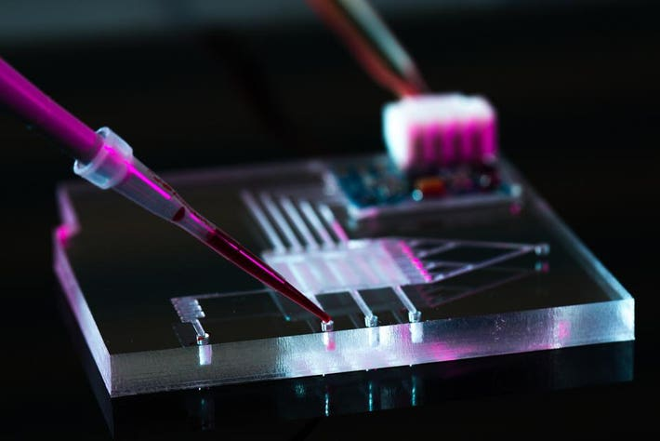
In 2005, the National Science Foundation (NSF) awarded a grant to the National Center for Manufacturing Sciences (NCMS) to poll over 6,000 senior-level executives in leading U.S. organizations with leadership, technology or strategic research and development (R&D) responsibility to assess the outcome of growing private and public investments made in nano-technology under the National Nanotechnology Initiative (NNI). The overarching objective in conducting this largest known cross-industry benchmark study was to determine whether surveyed organizations treat nanotechnology differently from any other generation of advanced science and technology.
Technology Literature Review
Introduction to Nanotechnology
Objectives
of the topic
Technology Observations
History of Nanotechnology
1
2
01
3
PRESENTATION OF
NANOTECHNOLOGY
TOPIC OBJECTIVES
What is Nanotech?
Scope
and limitation
Examples of Discoveries and Developments Enabling Nanotechnology from Pre-modern Era to Modern Era
Electronics and Computing
Medicine and Healthcare
02
Energy
and Environment
to provide an in-depth knowledge of nanotechnology
to examine the development of nanotechnology throughout time, from ancient times to the present
OBJECTIVES
TABLE OF CONTENTS
Introduction
to Nanotechnology
03
Nanotechnology refers to the branch of science and engineering devoted to designing, producing, and using structures, devices, and systems by manipulating atoms and molecules at nanoscale.
SCOPE AND LIMITATION
History
of Nanotechnology
Conclusion
/
RECOMMENDATION
to show the pros and cons of nanotechnology
04
to elaborate the importance of Nanotechnology
history
S & L
SUMMARY
Contents
PRESENTATION
introduction
USES AND
FUNCTIONS
IMPORTANCE AND BENEFITS
LITERATURE REVIEW AND SUPPORTING INFORMATION
OBJECTIVES
5
Presentation
of Nanotechnology
4
05
6
to explain how Nanotechnology works in different areas
to outline and describe some of the application areas of Nanotechnology
In the natural world, there are many examples of structures with one or more nanometer dimensions, and many technologies have incidentally involved such nanostructures for many years, but only recently has it been possible to do it intentionally.
Summary
of the topic
Nanosensors and Nanodevices
Nanotechnology is the manipulation of matter on a near-atomic scale to produce new structures, materials and devices. The technology promises scientific advancement in many sectors such as medicine, consumer products, energy, materials and manufacturing.
Materials
Science
TECHNOLOGY LITERATURE REVIEW
Nanoelectronics and
Photonics
06
TECHNOLOGY OBSERVATIONS
SURVEYS AND TECHNOLOGY EVALUATION
Conclusion
and recommendation
07
Surveys and Technology Evaluation
This technological branch manipulates the molecular structure of materials to change their intrinsic properties and obtain others with revolutionary applications. This is the case of graphene — modified carbon harder than steel, lighter than aluminum and almost transparent — or nanoparticles used in areas such as electronics, energy, biomedicine or defense.
There are bright and dark spots in the future of nanotechnology. On the one hand, the sector is expected to grow globally, driven by technological advances, increased government support, increased private investment and growing demand for smaller devices, to name a few. However, the environmental, health and safety risks of nanotechnology and concerns related to its commercialization could hamper market expansion.
Nanotechnology is the manipulation of matter on a near-atomic scale to produce new structures, materials and devices. The technology promises scientific advancement in many The metric established by NSF was 300 survey responses to develop a credible profile – the survey netted 594 completed responses, representing a response rate of 10%. such as medicine, consumer products, energy, materials and manufacturing.

Slide 32
Technology Literature Review
Surveys and Technology Evaluation
In 2005, the National Science Foundation (NSF) awarded a grant to the National Center for Manufacturing Sciences (NCMS) to poll over 6,000 senior-level executives in leading U.S. organizations with leadership, technology or strategic research and development (R&D) responsibility to assess the outcome of growing private and public investments made in nano-technology under the National Nanotechnology Initiative (NNI). The overarching objective in conducting this largest known cross-industry benchmark study was to determine whether surveyed organizations treat nanotechnology differently from any other generation of advanced science and technology.
Introduction to Nanotechnology
Objectives
of the topic
History of Nanotechnology
1
2
01
3
PRESENTATION OF
NANOTECHNOLOGY
TOPIC OBJECTIVES
What is Nanotech?
Scope
and limitation
Examples of Discoveries and Developments Enabling Nanotechnology from Pre-modern Era to Modern Era
Electronics and Computing
Medicine and Healthcare
02
Energy
and Environment
Surveys and Technology Evaluation
to provide an in-depth knowledge of nanotechnology
to examine the development of nanotechnology throughout time, from ancient times to the present
OBJECTIVES
TABLE OF CONTENTS
Introduction
to Nanotechnology
03
Nanotechnology refers to the branch of science and engineering devoted to designing, producing, and using structures, devices, and systems by manipulating atoms and molecules at nanoscale.
Nanotechnology is the manipulation of matter on a near-atomic scale to produce new structures, materials and devices. The technology promises scientific advancement in many The metric established by NSF was 300 survey responses to develop a credible profile – the survey netted 594 completed responses, representing a response rate of 10%. such as medicine, consumer products, energy, materials and manufacturing.
SCOPE AND LIMITATION
History
of Nanotechnology
Conclusion
/
RECOMMENDATION
to show the pros and cons of nanotechnology
04
to elaborate the importance of Nanotechnology
history
S & L
SUMMARY
Contents
PRESENTATION
introduction
USES AND
FUNCTIONS
IMPORTANCE AND BENEFITS
LITERATURE REVIEW AND SUPPORTING INFORMATION
OBJECTIVES
5
Presentation
of Nanotechnology
4
05
6
to explain how Nanotechnology works in different areas
to outline and describe some of the application areas of Nanotechnology
In the natural world, there are many examples of structures with one or more nanometer dimensions, and many technologies have incidentally involved such nanostructures for many years, but only recently has it been possible to do it intentionally.
Summary
of the topic
Materials
Science
Nanoelectronics and
Photonics
06
Nanosensors and Nanodevices
TECHNOLOGY OBSERVATIONS
TECHNOLOGY LITERATURE REVIEW
SURVEYS AND TECHNOLOGY EVALUATION
Conclusion
and recommendation
07
Nanotechnology is the manipulation of matter on a near-atomic scale to produce new structures, materials and devices. The technology promises scientific advancement in many sectors such as medicine, consumer products, energy, materials and manufacturing.

Slide 33
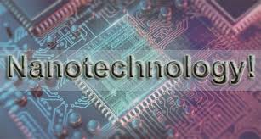
Surveys and Technology Evaluation
Nanotechnology is the manipulation of matter on a near-atomic scale to produce new structures, materials and devices. The technology promises scientific advancement in many The metric established by NSF was 300 survey responses to develop a credible profile – the survey netted 594 completed responses, representing a response rate of 10%. such as medicine, consumer products, energy, materials and manufacturing.
Status of Nanotechnology in the Philippines
Introduction to Nanotechnology
Objectives
of the topic
History of Nanotechnology
1
2
3
Surveys and Technology Evaluation
01
PRESENTATION OF
NANOTECHNOLOGY
TOPIC OBJECTIVES
What is Nanotech?
Scope
and limitation
Examples of Discoveries and Developments Enabling Nanotechnology from Pre-modern Era to Modern Era
Electronics and Computing
Medicine and Healthcare
02
Energy
and Environment
to provide an in-depth knowledge of nanotechnology
to examine the development of nanotechnology throughout time, from ancient times to the present
OBJECTIVES
TABLE OF CONTENTS
Introduction
to Nanotechnology
03
Nanotechnology refers to the branch of science and engineering devoted to designing, producing, and using structures, devices, and systems by manipulating atoms and molecules at nanoscale.
SCOPE AND LIMITATION
History
of Nanotechnology
Conclusion
/
RECOMMENDATION
to show the pros and cons of nanotechnology
04
to elaborate the importance of Nanotechnology
history
S & L
SUMMARY
Contents
PRESENTATION
introduction
USES AND
FUNCTIONS
IMPORTANCE AND BENEFITS
LITERATURE REVIEW AND SUPPORTING INFORMATION
OBJECTIVES
5
Presentation
of Nanotechnology
4
6
The NCMS survey of nearly 600 industry executives indicates that the state of the U.S. Nanomanufacturing Industry is generally vital, innovative and competitive for demonstrated passive nanotechnology products with many two-dimensional (2D) product applications growing rapidly for end-uses across diverse industry sectors. The survey confirms that the U.S. has the best-developed and mature research facilities, entrepreneurial culture and governance infrastructure for promoting new nanotechnology driven economic development.
05
to explain how Nanotechnology works in different areas
to outline and describe some of the application areas of Nanotechnology
In the natural world, there are many examples of structures with one or more nanometer dimensions, and many technologies have incidentally involved such nanostructures for many years, but only recently has it been possible to do it intentionally.
Summary
of the topic
Materials
Science
Nanoelectronics and
Photonics
06
Nanosensors and Nanodevices
TECHNOLOGY OBSERVATIONS
TECHNOLOGY LITERATURE REVIEW
SURVEYS AND TECHNOLOGY EVALUATION
Conclusion
and recommendation
07
The potential of nanotechnology has been acknowledged by the Philippines, as such a technology roadmap was established 10 years ago to guide the development of nanotechnology in the country. However, the presence of the COVID-19 pandemic has drastically affected the timeline of most technological roadmaps. Several barriers and constraints for the adoption of nanotechnology in the Philippines were identified. On the other hand, the facilitating factors that would enable the acceptance of the technology in the country was also explored.
Moreover, the impacts brought about by the advancements in nanotechnology towards major sectors such as the economy, environment, and society were also discussed. From the gathered information on the trends, factors for adoption and impacts of the technology, policy recommendations were raised to help establish the roots of nanotechnology in the country and support it in its technological maturity.
In 2005, the National Science Foundation (NSF) awarded a grant to the National Center for Manufacturing Sciences (NCMS) to poll over 6,000 senior-level executives in leading U.S. organizations with leadership, technology or strategic research and development (R&D) responsibility to assess the outcome of growing private and public investments made in nano-technology under the National Nanotechnology Initiative (NNI). The overarching objective in conducting this largest known cross-industry benchmark study was to determine whether surveyed organizations treat nanotechnology differently from any other generation of advanced science and technology.

Slide 34
Pros and Cons of Nanotechnology
Surveys and Technology Evaluation
Introduction to Nanotechnology
History of Nanotechnology
Objectives
of the topic
1
2
01
3
PRESENTATION OF
NANOTECHNOLOGY
Status of Nanotechnology in the Philippines
TOPIC OBJECTIVES
What is Nanotech?
Scope
and limitation
Examples of Discoveries and Developments Enabling Nanotechnology from Pre-modern Era to Modern Era
Electronics and Computing
Medicine and Healthcare
02
Energy
and Environment
to provide an in-depth knowledge of nanotechnology
to examine the development of nanotechnology throughout time, from ancient times to the present
OBJECTIVES
TABLE OF CONTENTS
Introduction
to Nanotechnology
03
Nanotechnology refers to the branch of science and engineering devoted to designing, producing, and using structures, devices, and systems by manipulating atoms and molecules at nanoscale.
The potential of nanotechnology has been acknowledged by the Philippines, as such a technology roadmap was established 10 years ago to guide the development of nanotechnology in the country. However, the presence of the COVID-19 pandemic has drastically affected the timeline of most technological roadmaps. Several barriers and constraints for the adoption of nanotechnology in the Philippines were identified. On the other hand, the facilitating factors that would enable the acceptance of the technology in the country was also explored.
Moreover, the impacts brought about by the advancements in nanotechnology towards major sectors such as the economy, environment, and society were also discussed. From the gathered information on the trends, factors for adoption and impacts of the technology, policy recommendations were raised to help establish the roots of nanotechnology in the country and support it in its technological maturity.
SCOPE AND LIMITATION
History
of Nanotechnology
Conclusion
/
RECOMMENDATION
to show the pros and cons of nanotechnology
04
to elaborate the importance of Nanotechnology
history
S & L
SUMMARY
Contents
PRESENTATION
introduction
USES AND
FUNCTIONS
IMPORTANCE AND BENEFITS
LITERATURE REVIEW AND SUPPORTING INFORMATION
OBJECTIVES
5
Presentation
of Nanotechnology
4
05
6
to explain how Nanotechnology works in different areas
to outline and describe some of the application areas of Nanotechnology
In the natural world, there are many examples of structures with one or more nanometer dimensions, and many technologies have incidentally involved such nanostructures for many years, but only recently has it been possible to do it intentionally.
Summary
of the topic
Materials
Science
Nanoelectronics and
Photonics
06
Nanosensors and Nanodevices
TECHNOLOGY OBSERVATIONS
TECHNOLOGY LITERATURE REVIEW
SURVEYS AND TECHNOLOGY EVALUATION
Conclusion
and recommendation
07
The NCMS survey of nearly 600 industry executives indicates that the state of the U.S. Nanomanufacturing Industry is generally vital, innovative and competitive for demonstrated passive nanotechnology products with many two-dimensional (2D) product applications growing rapidly for end-uses across diverse industry sectors. The survey confirms that the U.S. has the best-developed and mature research facilities, entrepreneurial culture and governance infrastructure for promoting new nanotechnology driven economic development.

Slide 35
Status of Nanotechnology in the Philippines
Introduction to Nanotechnology
Objectives
of the topic
History of Nanotechnology
1
2
01
3
PRESENTATION OF
NANOTECHNOLOGY
Pros and Cons of Nanotechnology
TOPIC OBJECTIVES
What is Nanotech?
Scope
and limitation
Examples of Discoveries and Developments Enabling Nanotechnology from Pre-modern Era to Modern Era
Electronics and Computing
Medicine and Healthcare
02
Energy
and Environment
to provide an in-depth knowledge of nanotechnology
to examine the development of nanotechnology throughout time, from ancient times to the present
OBJECTIVES
TABLE OF CONTENTS
Introduction
to Nanotechnology
03
Nanotechnology refers to the branch of science and engineering devoted to designing, producing, and using structures, devices, and systems by manipulating atoms and molecules at nanoscale.
PROS
CONS
SCOPE AND LIMITATION
History
of Nanotechnology
Conclusion
/
RECOMMENDATION
to show the pros and cons of nanotechnology
04
to elaborate the importance of Nanotechnology
history
S & L
SUMMARY
Contents
PRESENTATION
introduction
USES AND
FUNCTIONS
IMPORTANCE AND BENEFITS
LITERATURE REVIEW AND SUPPORTING INFORMATION
OBJECTIVES
Increased strength and durability
Enhanced Performance
Medical Advancements
Improved energy efficiency
Environmental Applications
Health and Safety Risks
Safety and environmental concerns
Ethical and Societal Issues
Cost and Accessibility
Access to Hazardous Weapons
5
Presentation
of Nanotechnology
4
05
6
to explain how Nanotechnology works in different areas
to outline and describe some of the application areas of Nanotechnology
In the natural world, there are many examples of structures with one or more nanometer dimensions, and many technologies have incidentally involved such nanostructures for many years, but only recently has it been possible to do it intentionally.
Summary
of the topic
Materials
Science
Nanoelectronics and
Photonics
06
Nanosensors and Nanodevices
TECHNOLOGY OBSERVATIONS
TECHNOLOGY LITERATURE REVIEW
SURVEYS AND TECHNOLOGY EVALUATION
Conclusion
and recommendation
07
The potential of nanotechnology has been acknowledged by the Philippines, as such a technology roadmap was established 10 years ago to guide the development of nanotechnology in the country. However, the presence of the COVID-19 pandemic has drastically affected the timeline of most technological roadmaps. Several barriers and constraints for the adoption of nanotechnology in the Philippines were identified. On the other hand, the facilitating factors that would enable the acceptance of the technology in the country was also explored.
Moreover, the impacts brought about by the advancements in nanotechnology towards major sectors such as the economy, environment, and society were also discussed. From the gathered information on the trends, factors for adoption and impacts of the technology, policy recommendations were raised to help establish the roots of nanotechnology in the country and support it in its technological maturity.

Slide 36

Pros and Cons of Nanotechnology
Introduction to Nanotechnology
Objectives
of the topic
History of Nanotechnology
1
2
01
3
PRESENTATION OF
NANOTECHNOLOGY
TOPIC OBJECTIVES
What is Nanotech?
Scope
and limitation
Examples of Discoveries and Developments Enabling Nanotechnology from Pre-modern Era to Modern Era
Electronics and Computing
Medicine and Healthcare
02
Energy
and Environment
to provide an in-depth knowledge of nanotechnology
to examine the development of nanotechnology throughout time, from ancient times to the present
OBJECTIVES
TABLE OF CONTENTS
Introduction
to Nanotechnology
03
Nanotechnology refers to the branch of science and engineering devoted to designing, producing, and using structures, devices, and systems by manipulating atoms and molecules at nanoscale.
PROS
CONS
SCOPE AND LIMITATION
History
of Nanotechnology
Conclusion
/
RECOMMENDATION
to show the pros and cons of nanotechnology
04
to elaborate the importance of Nanotechnology
history
S & L
SUMMARY
LITERATURE REVIEW AND SUPPORTING INFORMATION
Contents
PRESENTATION
introduction
USES AND
FUNCTIONS
IMPORTANCE AND BENEFITS
TECHNOLOGY OBSERVATIONS
OBJECTIVES
Increased strength and durability
Enhanced Performance
Medical Advancements
Improved energy efficiency
Environmental Applications
Health and Safety Risks
Safety and environmental concerns
Ethical and Societal Issues
Cost and Accessibility
Access to Hazardous Weapons
5
Presentation
of Nanotechnology
4
05
6
to explain how Nanotechnology works in different areas
to outline and describe some of the application areas of Nanotechnology
In the natural world, there are many examples of structures with one or more nanometer dimensions, and many technologies have incidentally involved such nanostructures for many years, but only recently has it been possible to do it intentionally.
Summary
of the topic
Materials
Science
Nanoelectronics and
Photonics
06
Nanosensors and Nanodevices
TECHNOLOGY LITERATURE REVIEW
SURVEYS AND TECHNOLOGY EVALUATION
Status of Nanotechnology in the Philippines
PROS
AND
CONS
Conclusion
and recommendation
07

Slide 37
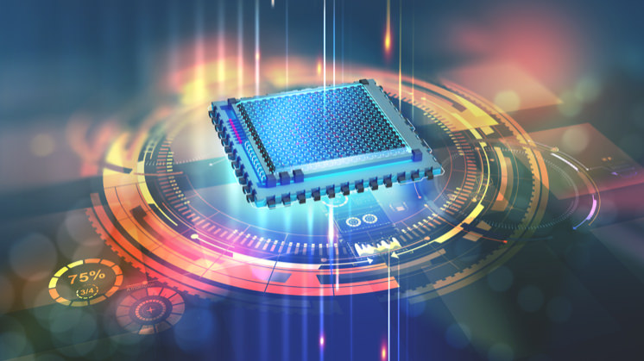


Pros and Cons of Nanotechnology
Introduction to Nanotechnology
Summary
Objectives
of the topic
History of Nanotechnology
1
2
01
3
PRESENTATION OF
NANOTECHNOLOGY
TOPIC OBJECTIVES
What is Nanotech?
Scope
and limitation
Examples of Discoveries and Developments Enabling Nanotechnology from Pre-modern Era to Modern Era
Electronics and Computing
Medicine and Healthcare
02
Energy
and Environment
to provide an in-depth knowledge of nanotechnology
to examine the development of nanotechnology throughout time, from ancient times to the present
OBJECTIVES
TABLE OF CONTENTS
Introduction
to Nanotechnology
03
Nanotechnology refers to the branch of science and engineering devoted to designing, producing, and using structures, devices, and systems by manipulating atoms and molecules at nanoscale.
PROS
CONS
SCOPE AND LIMITATION
History
of Nanotechnology
Conclusion
/
RECOMMENDATION
to show the pros and cons of nanotechnology
04
to elaborate the importance of Nanotechnology
history
S & L
LITERATURE REVIEW AND SUPPORTING INFORMATION
SUMMARY
Contents
PRESENTATION
introduction
USES AND
FUNCTIONS
IMPORTANCE AND BENEFITS
TECHNOLOGY OBSERVATIONS
OBJECTIVES
Increased strength and durability
Enhanced Performance
Medical Advancements
Improved energy efficiency
Environmental Applications
Health and Safety Risks
Safety and environmental concerns
Ethical and Societal Issues
Cost and Accessibility
Access to Hazardous Weapons
To summarize, nanotechnology is a field of science and engineering that focuses on manipulating atoms and molecules at the nanoscale to design, produce, and use structures, devices, and systems. While there have always been natural examples of structures with nanoscale dimensions, intentional manipulation of nanoscale structures has become possible only in recent years. Nanotechnology offers the potential for significant advancements in various industries by harnessing the unique properties and behavior of materials at the nanoscale.
Presentation
of Nanotechnology
4
5
05
6
to explain how Nanotechnology works in different areas
to outline and describe some of the application areas of Nanotechnology
In the natural world, there are many examples of structures with one or more nanometer dimensions, and many technologies have incidentally involved such nanostructures for many years, but only recently has it been possible to do it intentionally.
Summary
of the topic
Materials
Science
Nanoelectronics and
Photonics
06
Nanosensors and Nanodevices
TECHNOLOGY LITERATURE REVIEW
SURVEYS AND TECHNOLOGY EVALUATION
Status of Nanotechnology in the Philippines
PROS
AND
CONS
Conclusion
and recommendation
07

Slide 38

Introduction to Nanotechnology
Conclusion and Recommendation
Summary
Objectives
of the topic
History of Nanotechnology
1
2
01
3
PRESENTATION OF
NANOTECHNOLOGY
TOPIC OBJECTIVES
To summarize, nanotechnology is a field of science and engineering that focuses on manipulating atoms and molecules at the nanoscale to design, produce, and use structures, devices, and systems. While there have always been natural examples of structures with nanoscale dimensions, intentional manipulation of nanoscale structures has become possible only in recent years. Nanotechnology offers the potential for significant advancements in various industries by harnessing the unique properties and behavior of materials at the nanoscale.
In conclusion, nanotechnology offers significant potential for scientific advancements and innovation across various industries. However, it is crucial to proceed with caution, addressing safety concerns and ensuring ethical implementation. To maximize its benefits while minimizing risks, a collaborative and multidisciplinary approach involving scientists, engineers, policymakers, and the public is recommended. Transparent research, proactive risk assessment, and responsible regulation are key to harnessing nanotechnology's potential safely and ethically. Investment in education and training programs is also essential for preparing a skilled workforce capable of navigating the complexities of this emerging field.
What is Nanotech?
Scope
and limitation
Examples of Discoveries and Developments Enabling Nanotechnology from Pre-modern Era to Modern Era
Electronics and Computing
Medicine and Healthcare
02
Energy
and Environment
to provide an in-depth knowledge of nanotechnology
to examine the development of nanotechnology throughout time, from ancient times to the present
OBJECTIVES
TABLE OF CONTENTS
Introduction
to Nanotechnology
03
Nanotechnology refers to the branch of science and engineering devoted to designing, producing, and using structures, devices, and systems by manipulating atoms and molecules at nanoscale.
PROS
SCOPE AND LIMITATION
History
of Nanotechnology
to show the pros and cons of nanotechnology
to elaborate the importance of Nanotechnology
04
Conclusion
/
RECOMMENDATION
history
S & L
LITERATURE REVIEW AND SUPPORTING INFORMATION
SUMMARY
Contents
PRESENTATION
introduction
USES AND
FUNCTIONS
IMPORTANCE AND BENEFITS
TECHNOLOGY OBSERVATIONS
OBJECTIVES
Increased strength and durability
Enhanced Performance
Medical Advancements
Improved energy efficiency
Environmental Applications
5
Presentation
of Nanotechnology
4
05
6
to explain how Nanotechnology works in different areas
to outline and describe some of the application areas of Nanotechnology
In the natural world, there are many examples of structures with one or more nanometer dimensions, and many technologies have incidentally involved such nanostructures for many years, but only recently has it been possible to do it intentionally.
Summary
of the topic
Materials
Science
Nanoelectronics and
Photonics
06
Nanosensors and Nanodevices
TECHNOLOGY LITERATURE REVIEW
SURVEYS AND TECHNOLOGY EVALUATION
Status of Nanotechnology in the Philippines
PROS
AND
CONS
Conclusion
and recommendation
07

Slide 39
Introduction to Nanotechnology
Conclusion and Recommendation
Summary
Objectives
of the topic
History of Nanotechnology
1
2
01
3
PRESENTATION OF
NANOTECHNOLOGY
TOPIC OBJECTIVES
To summarize, nanotechnology is a field of science and engineering that focuses on manipulating atoms and molecules at the nanoscale to design, produce, and use structures, devices, and systems. While there have always been natural examples of structures with nanoscale dimensions, intentional manipulation of nanoscale structures has become possible only in recent years. Nanotechnology offers the potential for significant advancements in various industries by harnessing the unique properties and behavior of materials at the nanoscale.
In conclusion, nanotechnology offers significant potential for scientific advancements and innovation across various industries. However, it is crucial to proceed with caution, addressing safety concerns and ensuring ethical implementation. To maximize its benefits while minimizing risks, a collaborative and multidisciplinary approach involving scientists, engineers, policymakers, and the public is recommended. Transparent research, proactive risk assessment, and responsible regulation are key to harnessing nanotechnology's potential safely and ethically. Investment in education and training programs is also essential for preparing a skilled workforce capable of navigating the complexities of this emerging field.
What is Nanotech?
Scope
and limitation
Examples of Discoveries and Developments Enabling Nanotechnology from Pre-modern Era to Modern Era
Electronics and Computing
Medicine and Healthcare
02
Energy
and Environment
to provide an in-depth knowledge of nanotechnology
to examine the development of nanotechnology throughout time, from ancient times to the present
OBJECTIVES
TABLE OF CONTENTS
Introduction
to Nanotechnology
03
Nanotechnology refers to the branch of science and engineering devoted to designing, producing, and using structures, devices, and systems by manipulating atoms and molecules at nanoscale.
PROS
SCOPE AND LIMITATION
History
of Nanotechnology
to show the pros and cons of nanotechnology
to elaborate the importance of Nanotechnology
04
Conclusion
/
RECOMMENDATION
history
S & L
LITERATURE REVIEW AND SUPPORTING INFORMATION
SUMMARY
Contents
PRESENTATION
introduction
USES AND
FUNCTIONS
IMPORTANCE AND BENEFITS
TECHNOLOGY OBSERVATIONS
OBJECTIVES
Increased strength and durability
Enhanced Performance
Medical Advancements
Improved energy efficiency
Environmental Applications
5
Presentation
of Nanotechnology
4
05
6
to explain how Nanotechnology works in different areas
to outline and describe some of the application areas of Nanotechnology
In the natural world, there are many examples of structures with one or more nanometer dimensions, and many technologies have incidentally involved such nanostructures for many years, but only recently has it been possible to do it intentionally.
Summary
of the topic
Materials
Science
Nanoelectronics and
Photonics
06
Nanosensors and Nanodevices
TECHNOLOGY LITERATURE REVIEW
SURVEYS AND TECHNOLOGY EVALUATION
Status of Nanotechnology in the Philippines
PROS
AND
CONS
Conclusion
and recommendation
07

Slide 40



Analysis of the Events
Creative Elements
Relevance to the course
Opinion
Summary
Introduction of the film
Conclusion
Introduction
of the film
01
Thank you!
One of the movie's sequences depicts a family who is missing out on family time due of the internet, illustrating the detrimental effects of social media on us. There is also a scene when they explain to the interviewers how they can help and socialize with others using the applications they designed, demonstrating the advantages of using social media. They both make valid points about how social media use affects people, in my opinion. If you pay attention to the meticulous attention to detail in each scene, both the positive and negative outcomes that can result are depicted. We all utilize social media since we are digital natives, and we are aware of how to use it properly.
The Social Dilemma is a 2020 documentary Netflix film that was directed by Jeff Orlowski and produced by Larissa Rhodes. It was also written by the director himself with his two former fellow writers Davis Coombe and Vickie Curtis. The movie was premiered on January 26, 2020ain USA at the Sundance Film Festival and was released on Netflix on the 9th of September 2020.
The movie has won several awards, including the "Best Edited Single Documentary or Non-Fiction Programme", "Best Social Impact Film", "Outstanding Writing for a Nonfiction Program", "Outstanding Picture Editing for a Nonfiction Program", and "Advertising, Media & PR – Branded Content – Politics & Advocacy".
The movie was chosen to be watched on us, students was because we are already in adulthood state, and adults are the most common users of social media. The movie has shown what social media can do to our lives, both in good and harmful ways. It has also shown how powerful the social media are with the help of new technologies.
The concept of the social dilemma is ubiquitous in the field of Bachelor of Science in Information Technology. The study of ethical and social implications of technology design, development, deployment, and use is critical for the creation of safe, just, and sustainable technological systems that improve the quality of life for individuals and society. The relevance of social dilemma to the Bachelor of Science in Information Technology is two-fold.
First, it is essential to examine the potential unintended consequences of technology use, particularly in social contexts. For example, social media platforms can have detrimental impacts on mental health, privacy, and social interactions, as well as perpetuate biases and misinformation. These issues need to be addressed in the design and development of technology, and IT professionals need to be aware of the potential social pitfalls of technology to produce ethically responsible and socially conscious systems.
Also, IT professionals should be involved in promoting the responsible use of technology, particularly by creating inclusive and participatory digital spaces that encourage civic engagement, diversity, and cultural understanding. They should also be active in addressing digital divides and network failures that create disparities in access to vital information and online resources.
Moreover, IT professionals need to have a comprehensive understanding of the socioeconomic, political, and environmental implications of technology because it affects the way users interact with and understands the world. The Bachelor of Science in Information Technology is an excellent opportunity to learn about the way technology influences society and contribute to collaborative, interdisciplinary approaches to technological problem-solving.
Each character in this film plays a unique part and has a unique viewpoint on how using the internet will either negatively or positively affect us. In terms of how we utilize social media sites, they each have their own perspective. Also, they all have excellent ideas about how people will utilize the internet, and they all provide examples.
In overall, "The Social Dilemma" provides a powerful critique of social media and its impact on society. It highlights the ways in which these platforms can be addictive, harmful to mental health, and damaging to privacy and democracy. The film raises important questions about the responsibility of social media companies to regulate their platforms and protect their users, and it serves as a warning about the dangers of unchecked technological progress.
1
The Social Dilemma is a documentary film that explores the dark side of social media and its impact on society. The film features interviews with former executives and employees of major tech companies like Google, Facebook, and Twitter, who express their concerns about the negative effects of social media on people's mental health, democracy, privacy, and social relationships. The film argues that social media companies use algorithms that are designed to keep users hooked on their platforms and increase engagement, often at
the expense of users' well-being and privacy. This results in a polarized and divided society, where people are increasingly exposed to extremist content and disinformation, and where their data is collected and exploited for commercial and political purposes.
The documentary also highlights the growing power of tech companies and their potential to influence elections and shape public opinion. It calls for greater regulation of the industry and more ethical use of technology to promote social good.
Summary
of the film
02
Leader:
Fernandez, Mark Rickghell
Members:
Paz, Mike Laurence
Ramos, Christian Joshua
Triviño, Peter John
TABLE OF CONTENTS
Creative
elements of the film
03
When discussing how the internet can benefit us, their conversation has very clear dialogue. They clearly describe the positive benefits it has on humans. Also, every word they utter is fully defined, and the knowledge they provide is complete.
2
Contents
ELEMENTS
SUMMARY
OPINION
EVENTS
RELEVANCE
INTRODUCTION
CONCLUSION
Opinion
to the film
04
In conclusion, the documentary film was all about the manipulation. We are being manipulated by the different technological companies and platforms and us, the users, are not aware of it. Companies uses psychology against us for them to know us deeply. They try to collect data from us and use it against us to control our mind and our behavior. They will do anything just to engage us in using our gadgets and makes us hold for hours. In this way, their goals and plans have been accomplished.
3
One of the most stunning aspects of the movie is their camera work. Their camera work is incredibly meticulous, including the angles they used for the interview, the family scene, and the previous issues that they encounter.
Conclusion
of the film
05
This is in addition to those who gave life to the film through their use of color, symbol, tone, genre, and many other elements. They used everything well, with each scene being detailed. Everything that was wanted to be included in the documentation was included cleanly and without omission. Their use of tone and some clips from the previous issue drew my attention, which helped me understand and like this film more
Relevance
to the course
4
06
Trivino’s Opinion

